Slide 1






Needfinding for
Active Lifestyles
Cecilia, Malina, Nazanin, Pedro
Notes:
https://stanford.zoom.us/j/96296400371?pwd=aXRGT2FaTDRVYk0wbU82ZFVWMkx6Zz09

Slide 2





Contents
01
02
03
Domain Breakdown
Participant Overview
Main Qs
04
05
06
Empathy Map
Key Insights
What’s Next?

Slide 3
Domain Breakdown
01
Define Active Lifestyles
02
Consider activity in our own lifestyles and of those we have observed
03
Brainstorm elements of an active lifestyles that have been viewed as problematic or targeted with solutions

Slide 4




Domain Breakdown
Time Management
Physical Activity
Health
01
Define Active Lifestyles
Consider activity in our own lifestyles and of those we have observed
Tracking and Insights
02
Social and Networks
03
Brainstorm elements of an active lifestyles that have been viewed as problematic or targeted with solutions
Training and Skills Development
Daily Habit and Consistency
Motivation

Slide 5
Domain Breakdown
Time Management
01
Define Active Lifestyles
02
Consider activity in our own lifestyles and of those we have observed
03
Brainstorm elements of an active lifestyles that have been viewed as problematic or targeted with solutions
Daily Habit and Consistency
Motivation

Slide 6


“I know that I have time… but I still can’t bring myself to work out as much as I’d like.”

Slide 7

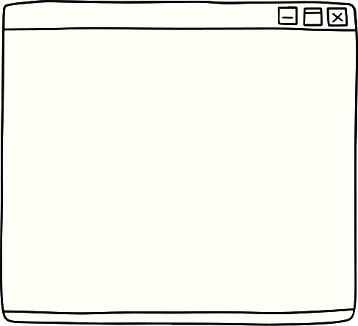


Daily obstacles between busy individuals and their active lifestyles

Slide 8
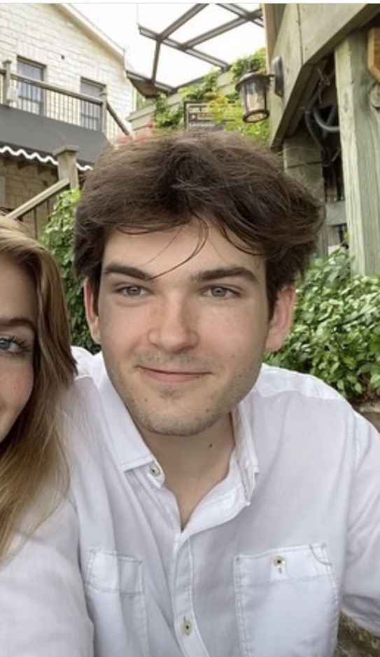
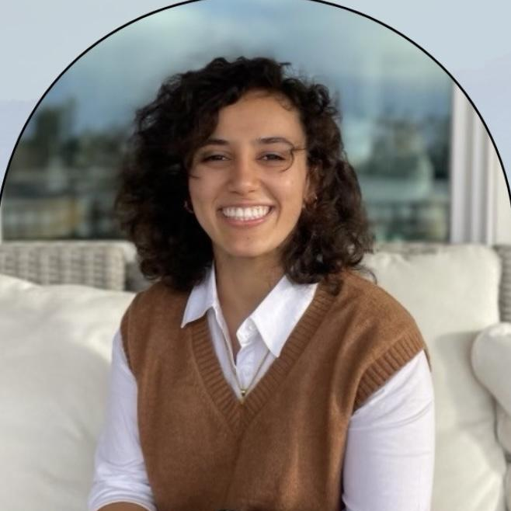
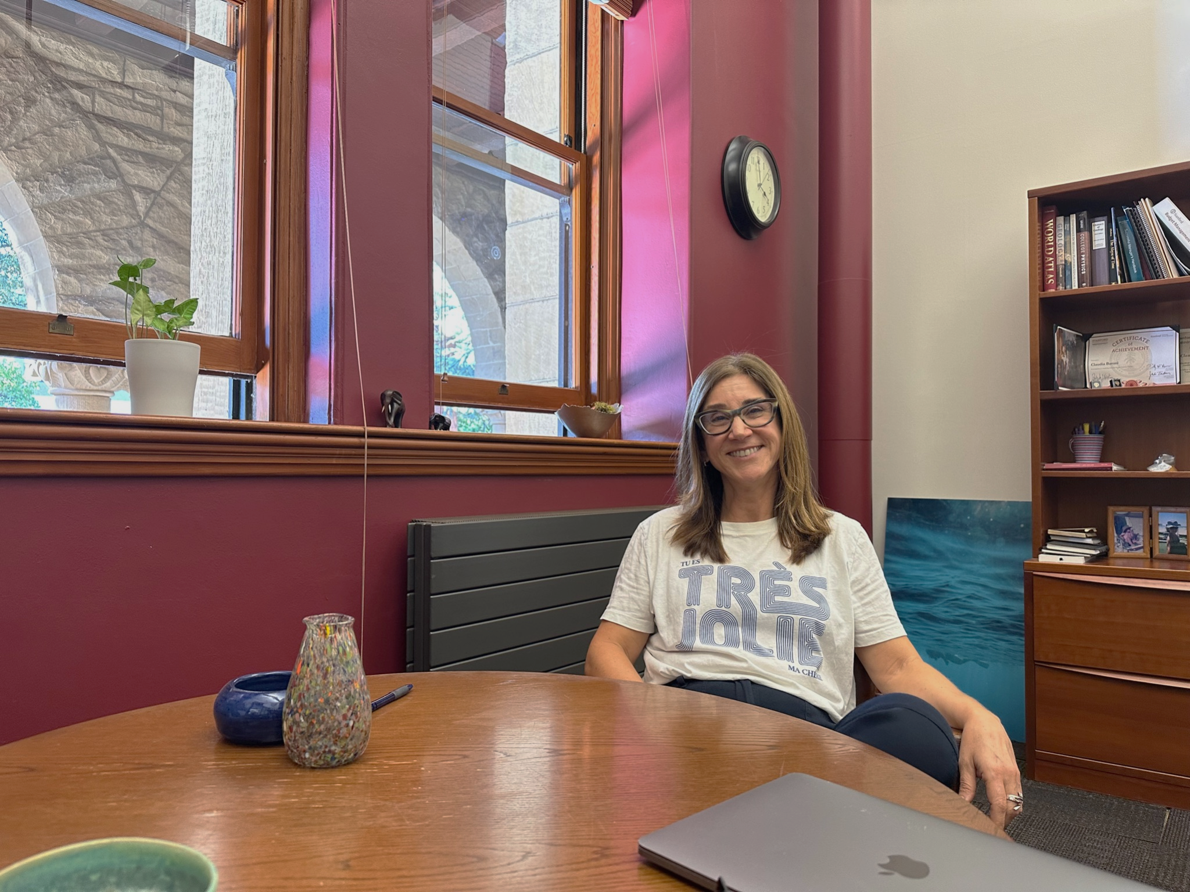
The subjects
Jack
Nadia
Claudia

Slide 9

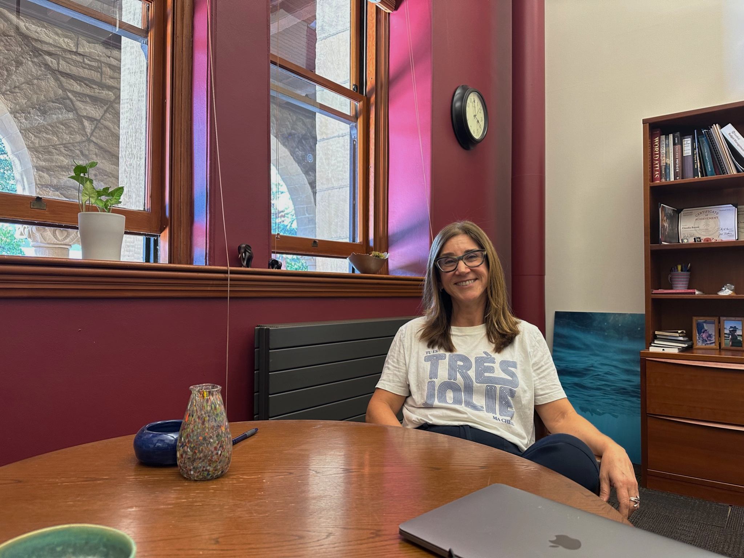

Passionate
Inactive
Active
Indifferent

Slide 10
Questions…
Jack, 21
Nadia, 21
Asking for consent
Building rapport
Never lead questions with solutions
Going with the interview flow
Guiding back to problem space
Claudia, 55

Slide 11
Questions…
Jack, 21
Nadia, 21
What does your typical day look like?
When I say ‘active lifestyle’ what do you think of?
How do you feel about your active habits?
When do you think you struggle?
What helps you keep up with your goals?
Tell me a story about a time you…
Claudia, 55

Slide 12


The interview was conducted in his dorm
Jack
Recruited through Slack
Stanford senior with a busy schedule
Never works out during the quarter, yet enjoys the gym

Slide 13
Jack
“I wish I could work on spacing out my work… going to bed earlier, and waking up early because the Stanford gym is super crowded unless you're going really early in the morning… ”
Stanford senior with a busy schedule

Slide 14
Insights
Despite being aware of his desire to lead an active lifestyle, Jack struggles with the final push of finding time for himself.
Needs
Organizing his time according to his availabilities and his environment.

Slide 15
The interview was conducted on Zoom
Nadia
Recruited through mutual friend
Berkeley senior with a busy schedule aspiring to have an active lifestyle
Works out 6-7 times a week for past 1-2 years

Slide 16
“I think time management was the biggest obstacle [to exercising]. And it was also a mental thing like, oh well, if I don't have time today, I'm not going to have time tomorrow”
Nadia
Berkeley senior with a busy schedule aspiring to have an active lifestyle
Notes:
weight lifting + power lifting
changes in her body
a new challenge / just started running

Slide 17
Insights
Nadia is able to workout consistently only through making it a priority in her schedule and making certain sacrifices in her life.
Needs
Convenient ways to navigate unpredictability in her schedule.
Notes:
Working out is a challenge. But one that’s worth. (She had to curate her schedule, but changing that was a big progress)
Midterms → skipped gym
School is unpredictable
Walking is a part of the routine
Google Calendar: “I use it religiously”
Apple health, fitBit, fitBod
two years to perfect her gym routine
walks 25k steps
woop / fitbit → data driven

Slide 18
Interviewed in her office at the main quad
Claudia
Contacted through socials/WhatsApp
Full time admin at Stanford, mother of 2, 55 years old
Very active; has not gone one day without working out for the past 30 years

Slide 19
“I got tired of apps that measured everything… I just want to move around”
Claudia
Full time admin at Stanford, mother of 2, 55 years old

Slide 20
Insights
Having an active lifestyle is deeply rooted around social life and longevity.
Needs
Structural support in building low-maintenance habits.

Slide 21
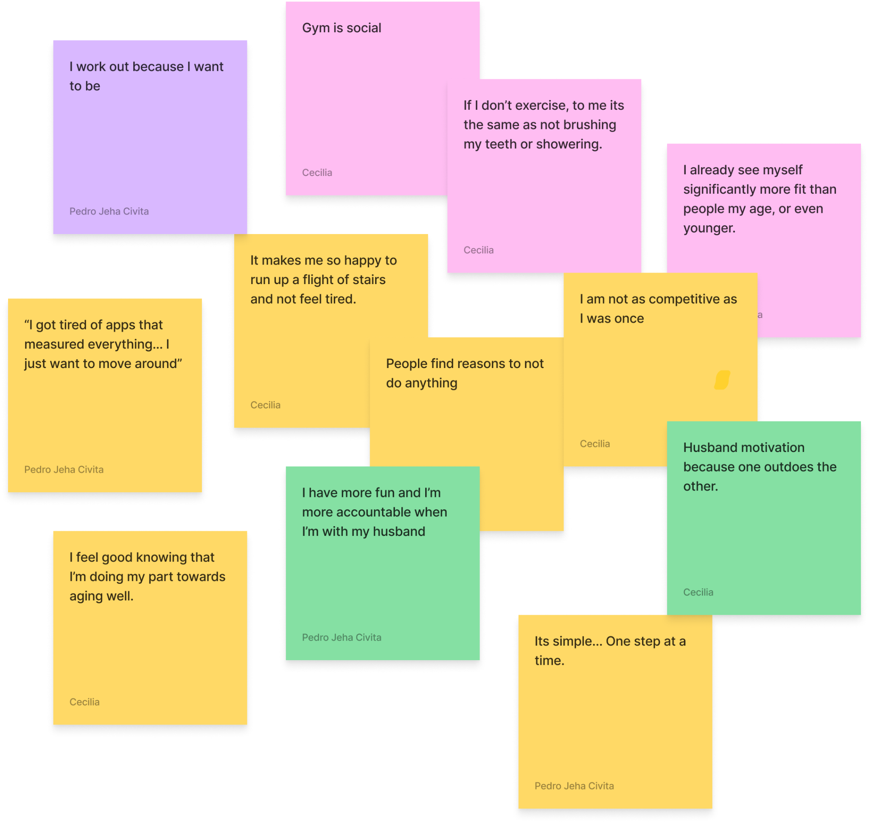
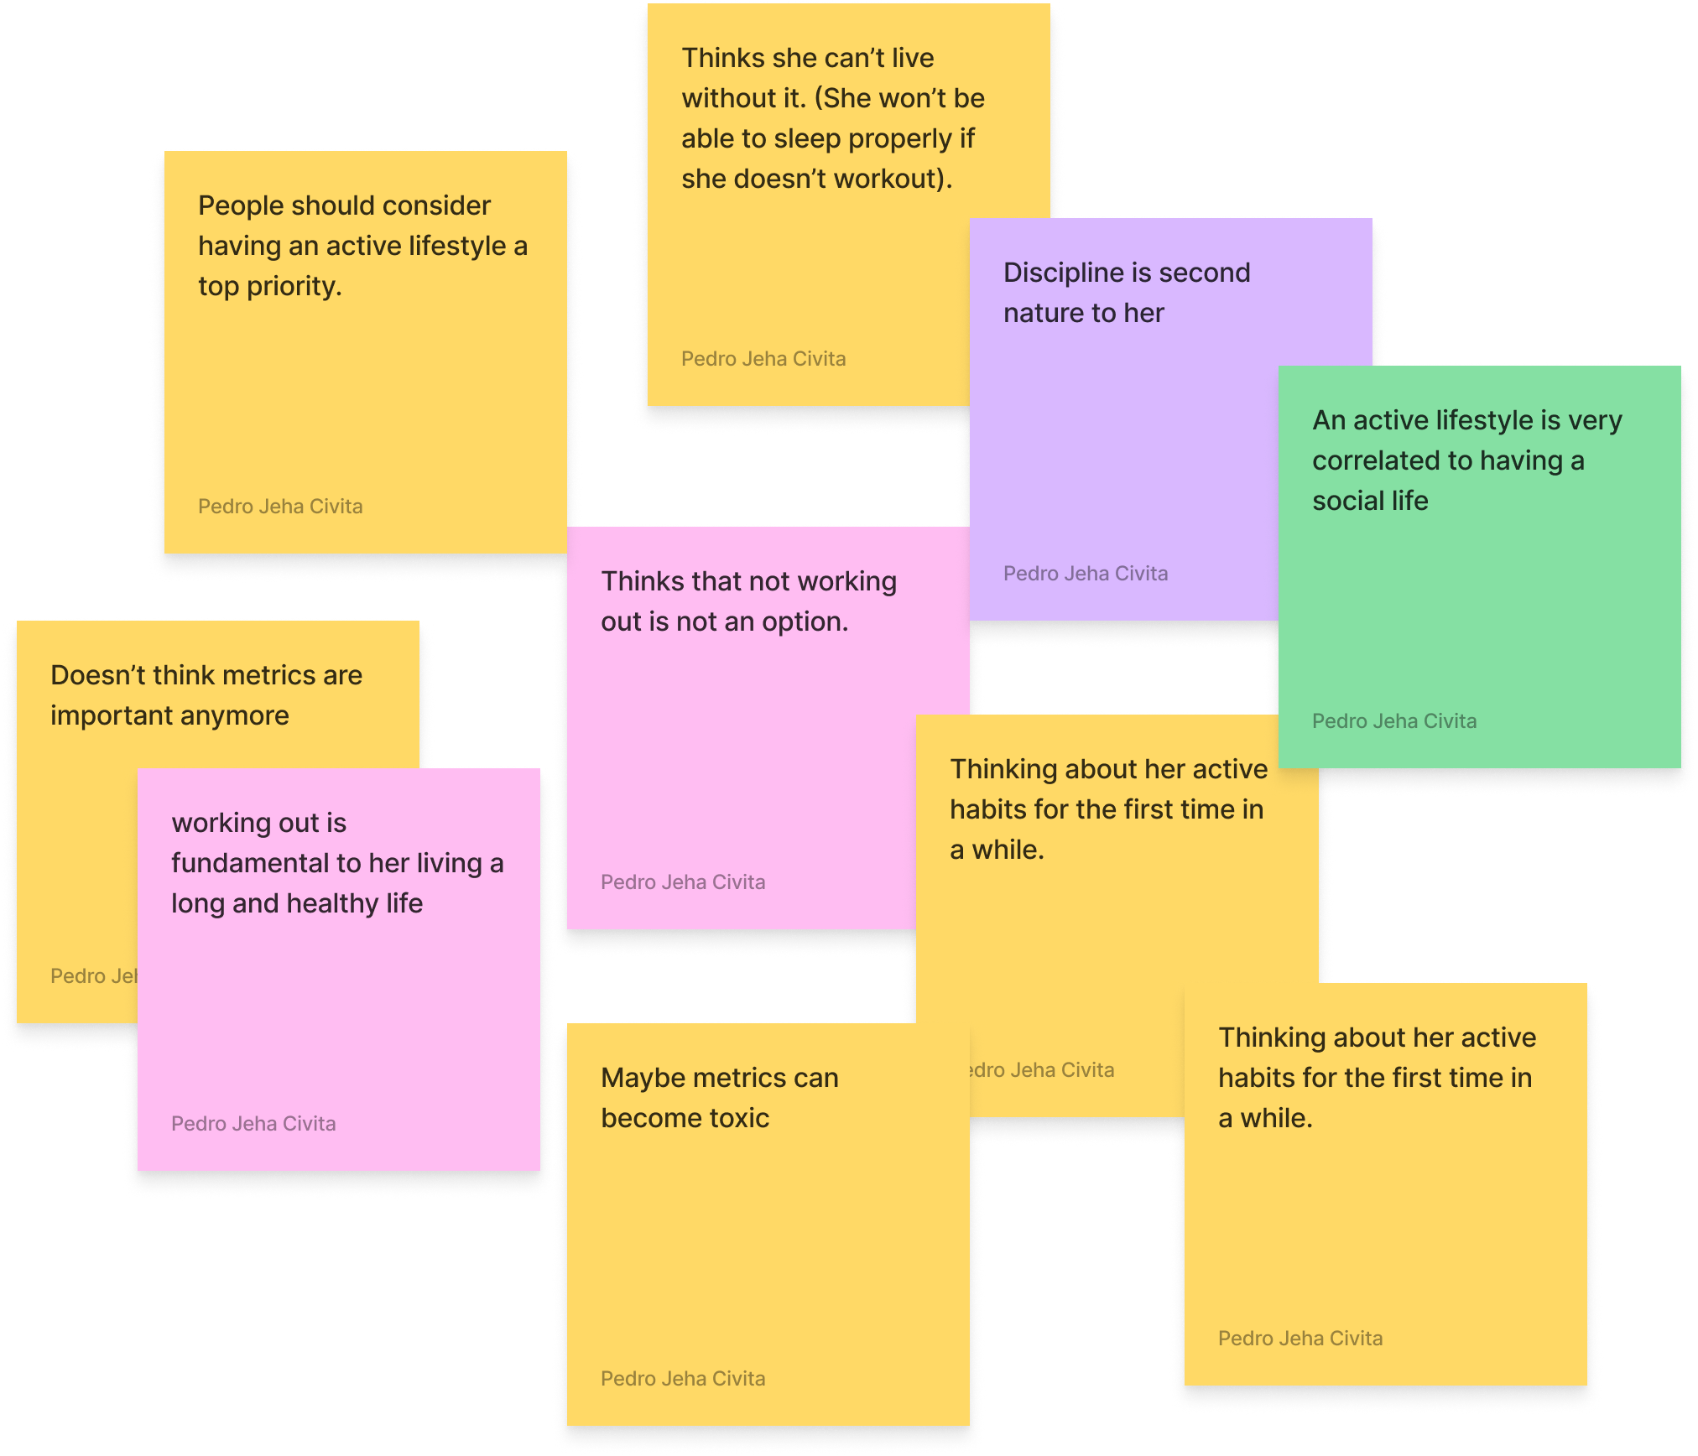
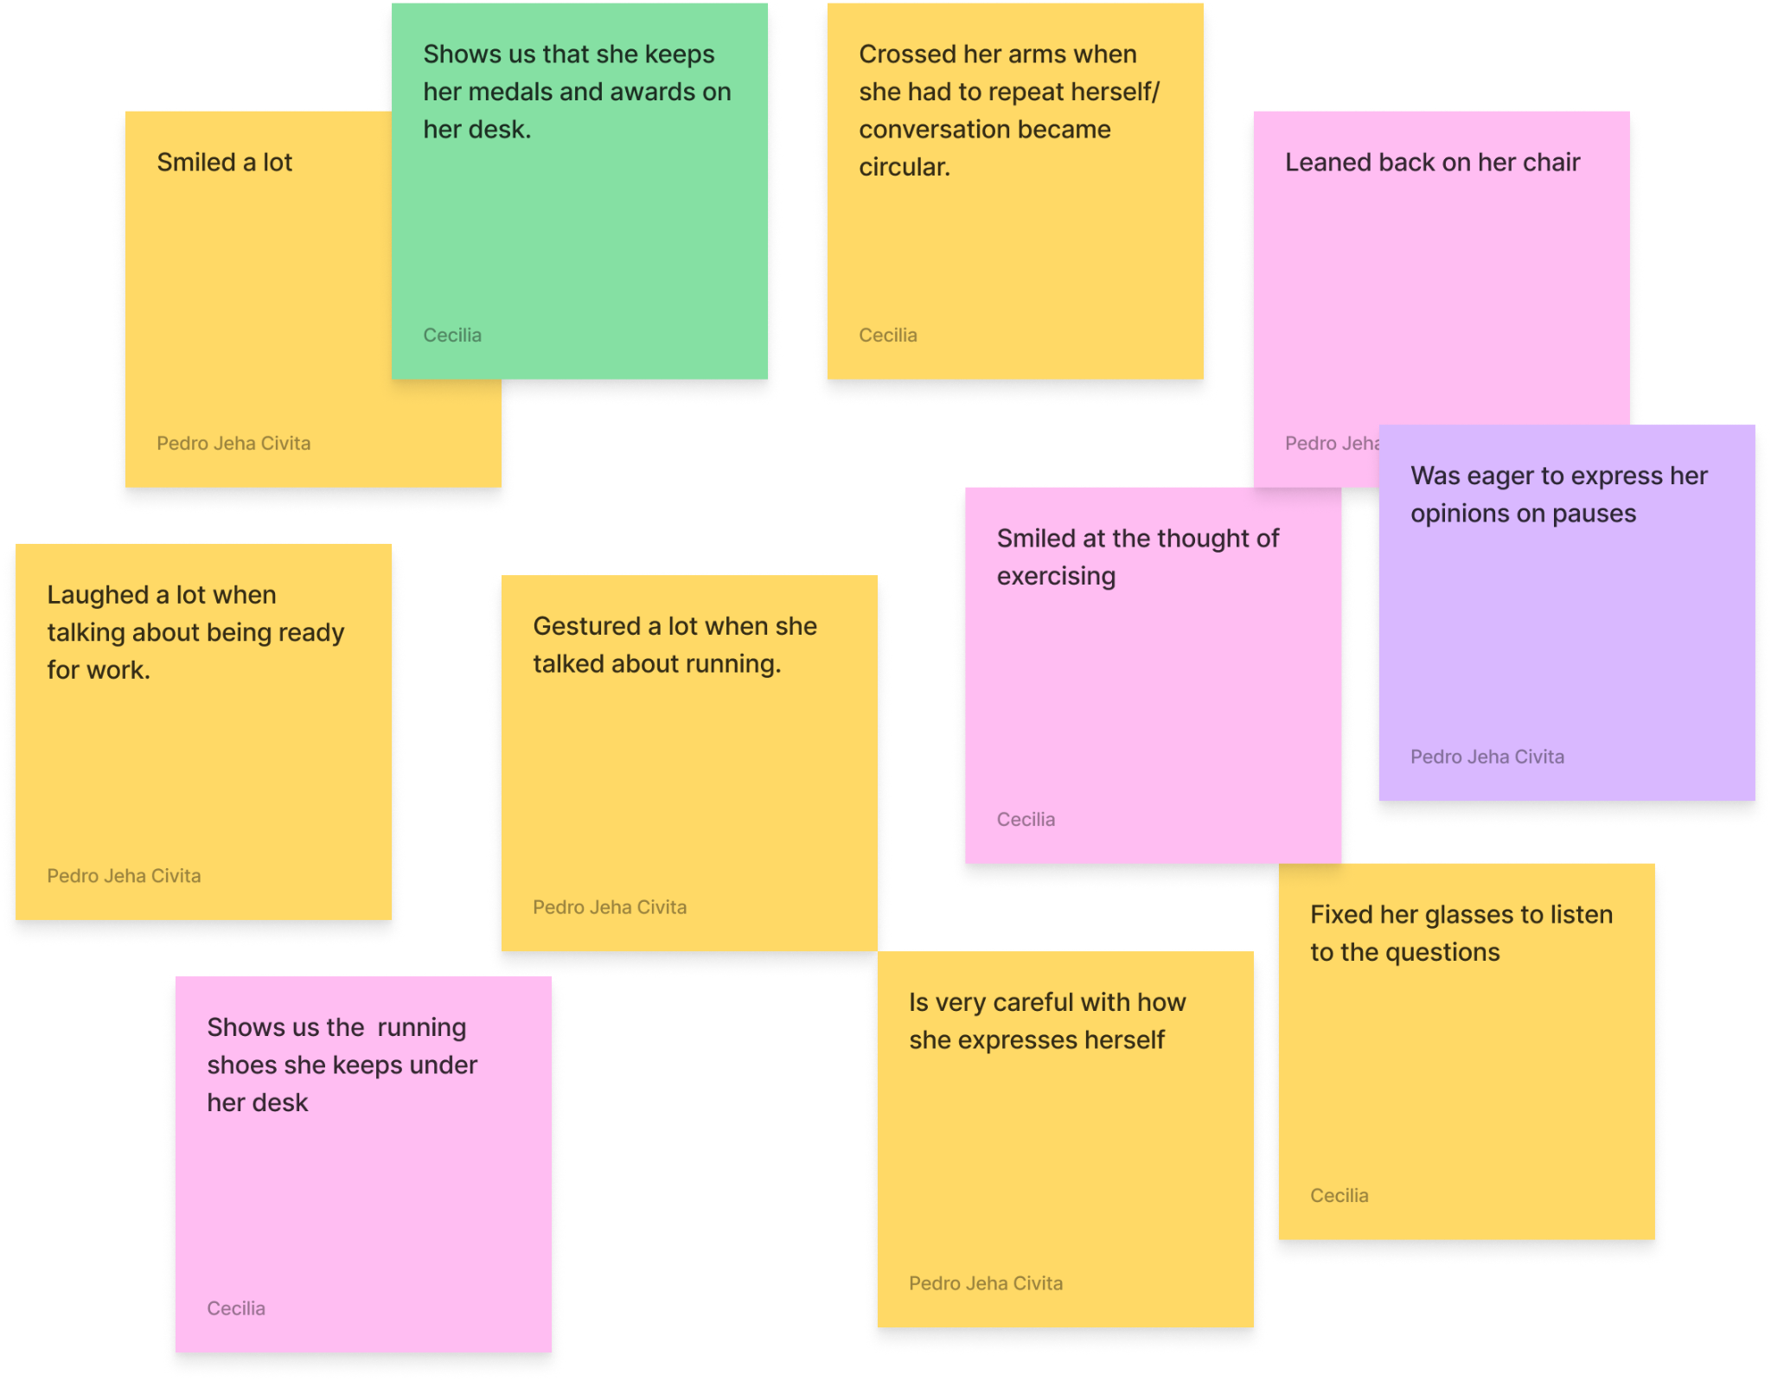
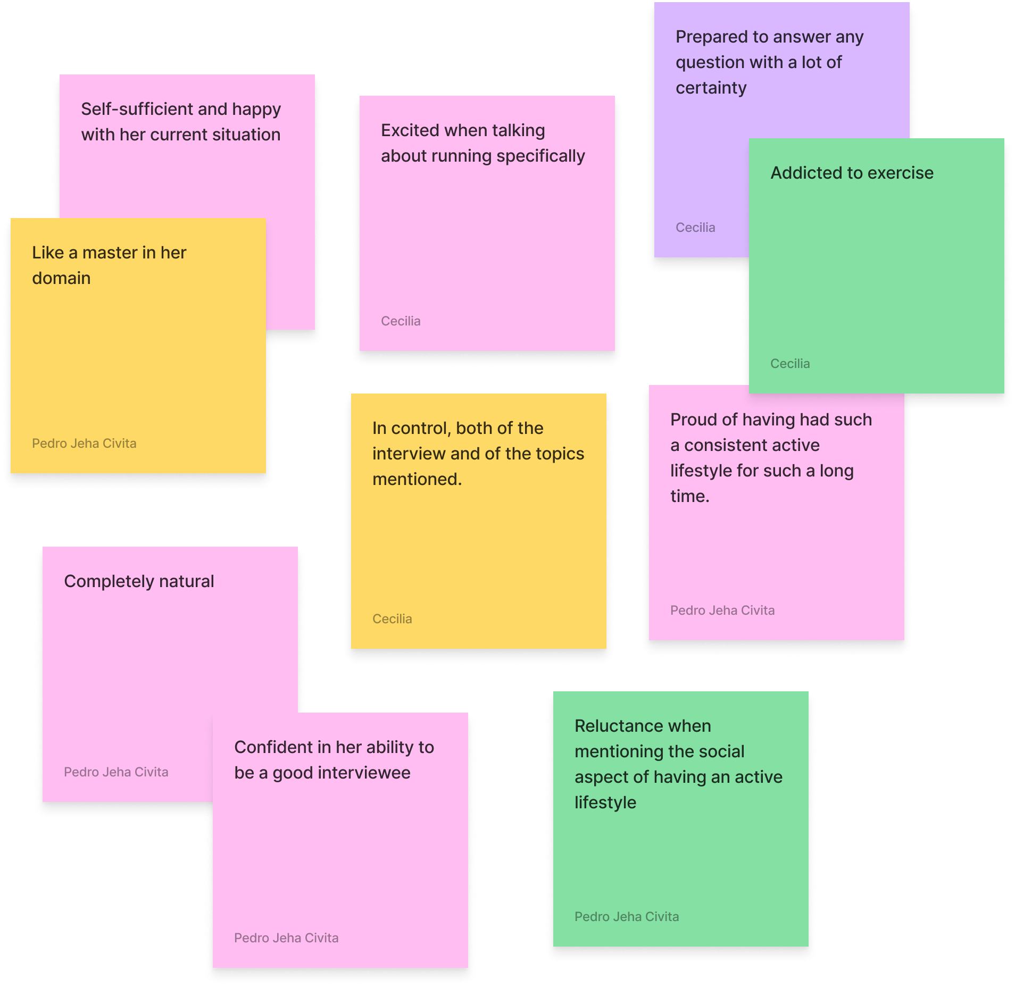

Slide 22
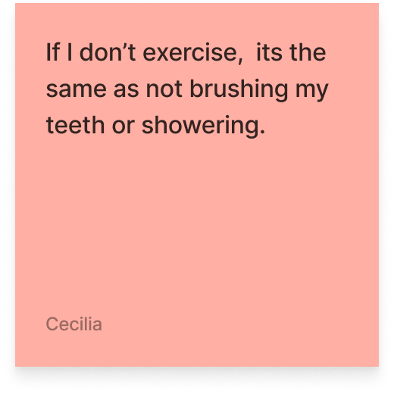
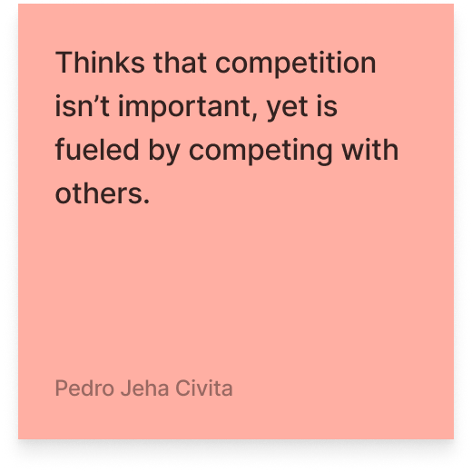
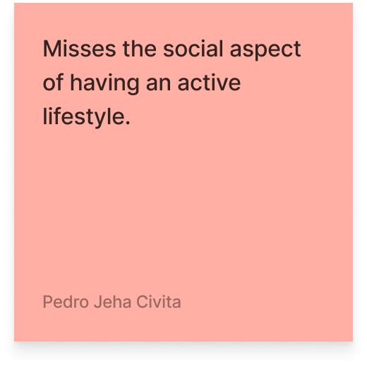
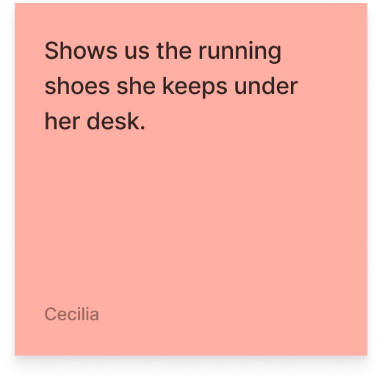
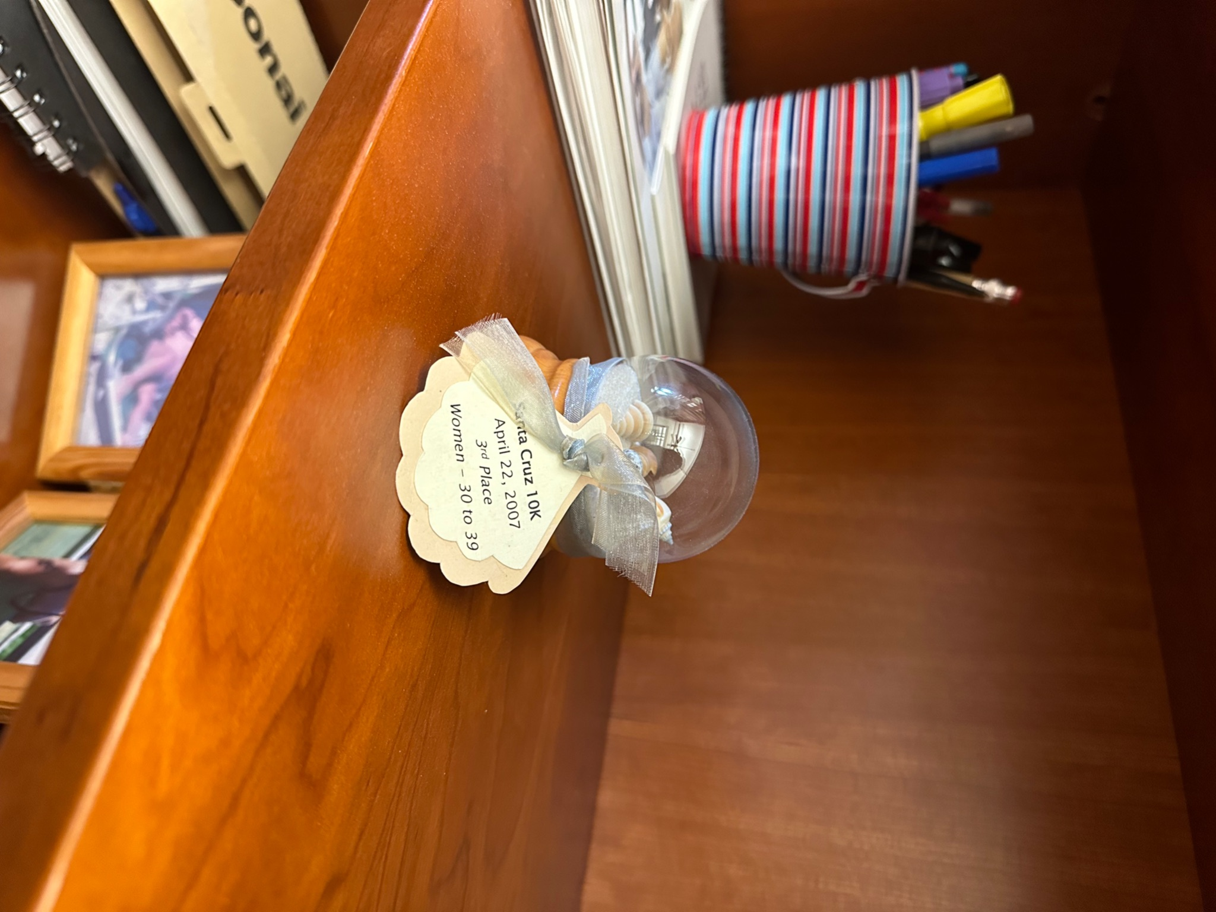
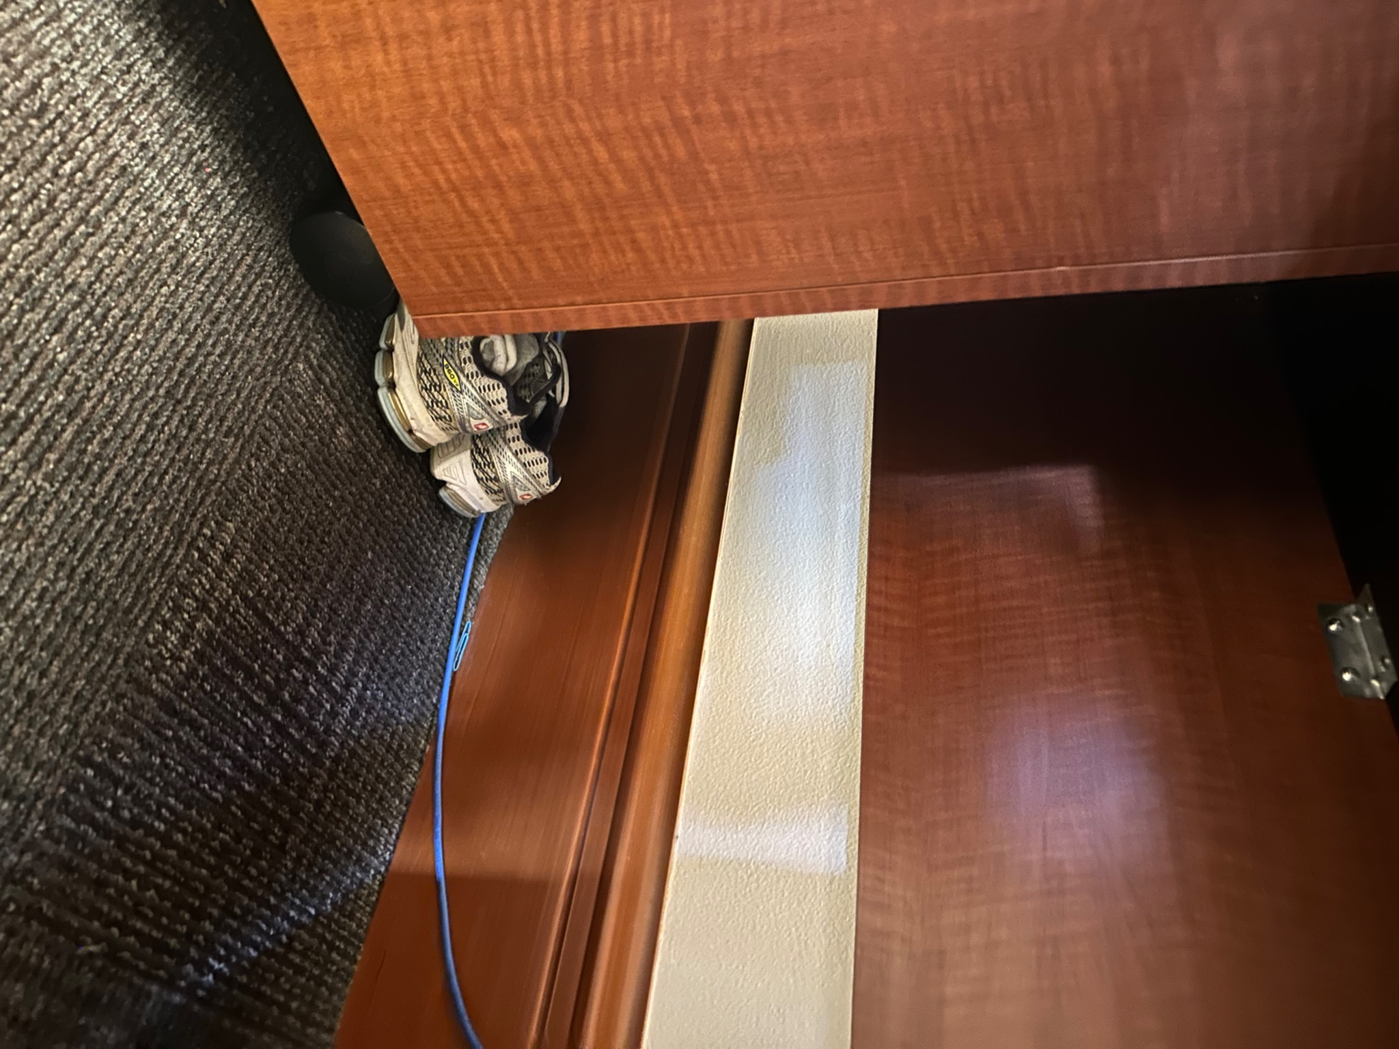

Slide 23



Key Learnings
People’s goals and definitions of active lifestyles are very diverse
Habits are built over a long period of time
People’s environment plays an extremely important role in daily activities

Slide 24


Next Steps
Digging deeper into our key learnings and insights, while considering ethical implications
Finding interviewees that fall more towards the middle of our spectrum
HMW analysis + POVs
Exploring contradictions and interviewee’s needs

Slide 25
Thank you!

